Slide 1


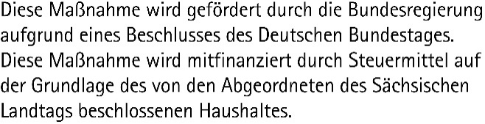
Data Science and AI for Medicine Training School
TRAINING: LLMs in Medicine
SPEAKER: Sanddhya Jayabalan

Slide 2


Slide 6
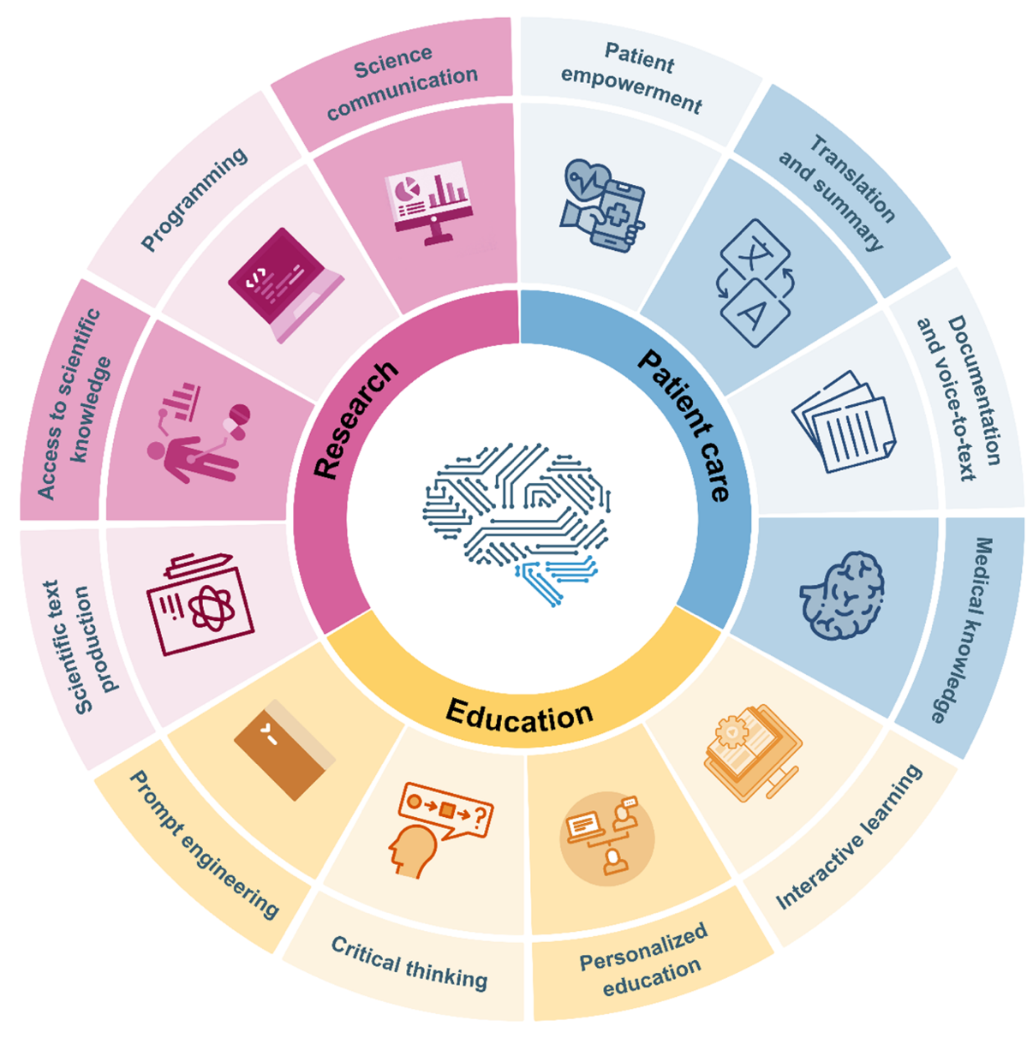
Large Language Models: A new class of tools in medicine
Clusmann, J., Kolbinger, F.R., Muti, H.S. et al. The future landscape of large language models in medicine. Commun Med 3, 141 (2023). https://doi.org/10.1038/s43856-023-00370-1

Slide 13
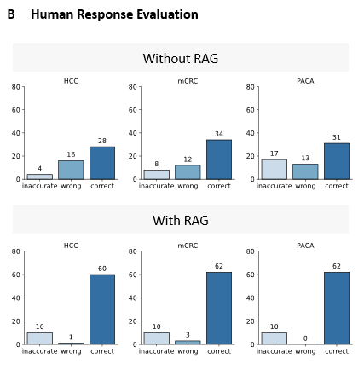

Slide 15

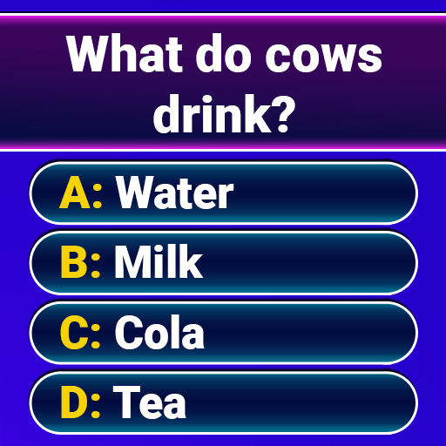
The era of agentic AI - from models to AI Agents
input
LLM
output
REAL LIFE?

Slide 18
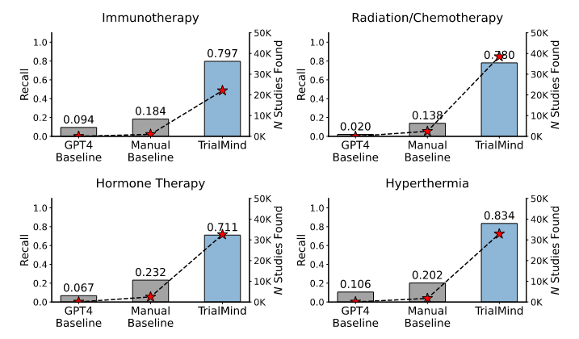
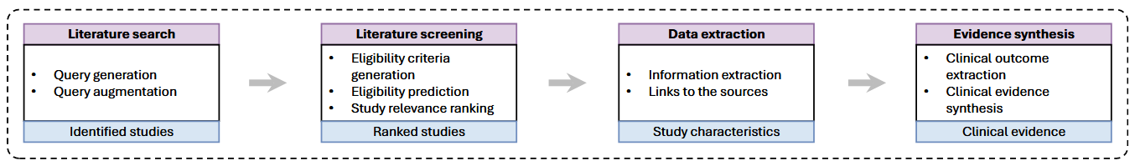
The era of agentic AI - from models to AI Agents
System-designed LLMs outperform humans and simple LLMs
Wang, Zifeng, et al. "Accelerating clinical evidence synthesis with large language models." npj Digital Medicine 8.1 (2025): 509.

Slide 19
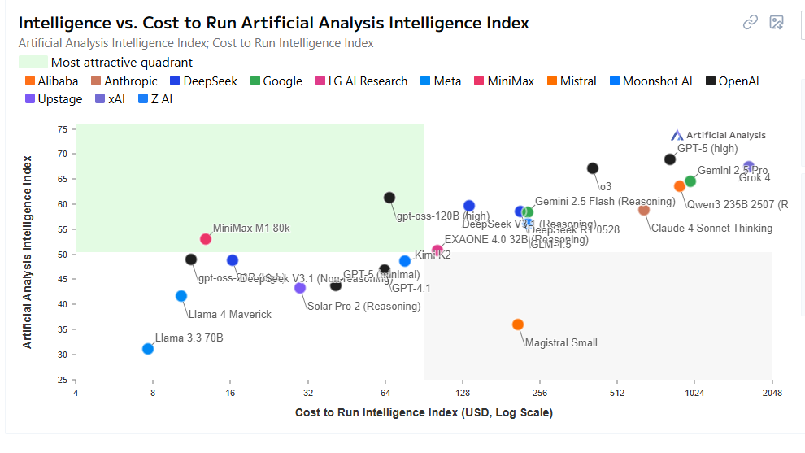

The era of agentic AI – questions for implementation
https://artificialanalysis.ai/

Slide 22
Any questions or remarks?
Let’s practice – Python Basics in Jupyter Lab

